Slide 1
Session 1
Introduction to the CLAS Standards
CLAS Training [ADD DATE]
[ADD PRESENTER NAME]
[ADD ORGANIZATION NAME]

Slide 2
Learning Objectives
Understand the historical context of CLAS
Differentiate between equality and equity
Recognize at least five cultural differences that humans experience
Explain the value of implementing CLAS

Slide 3
Activity

Slide 4
Key Terms
CLAS—Culturally and Linguistically Appropriate Services that are respectful and responsive to cultural practices, language, literacy, and communication needs
Limited English Proficiency (LEP)—speaking, hearing or reading English less than “very well” or insufficiently to ensure equal access to public services without language assistance
Language assistance (access)—interpretation (spoken or signed) and translation (written)

Slide 5
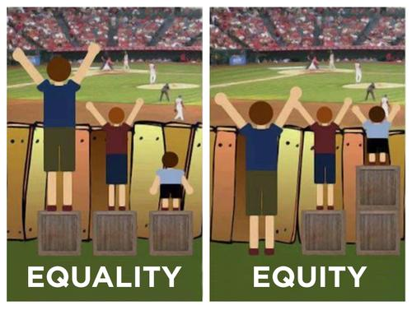
These images are credited to the City of Portland, Oregon, Office of Equity and Human Rights for their adaptation from the original graphic. http://www.portlandoregon.gov/oehr/article/449547

Slide 6
Civil Rights Act of 1964
Title VI
No person in the United States shall, on the ground of race, color, or national origin, be excluded from participation in, be denied the benefits of, or be subjected to discrimination under any program or activity receiving Federal financial assistance.

Slide 7
2000 Executive Order 13166: Meaningful access for LEP 2005 WA Executive Order 05-03: Plain talk 2006 CLAS Standards 2006 WA Senate Bill 6194: Multicultural education 2008 Joint Commission and the National Committee for Quality Assurance 2010 Patient Protection and Affordable Care Act 2012 Health Care and Education Reconciliation Act 2013 Enhanced CLAS Standards
Post Civil Rights Act

Slide 8
Who are CLAS Standards for?

Slide 9
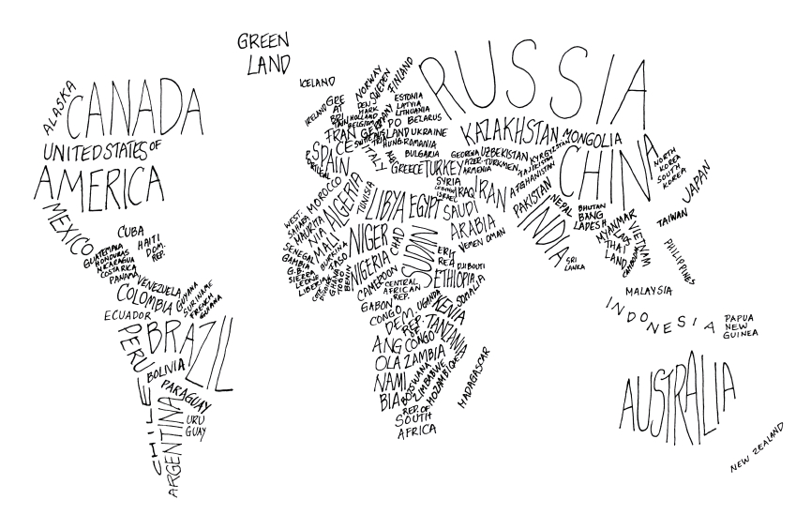
Cultural Differences
Age
Country of origin
Ethnicity
Gender
Language
Physical abilities
Race
Religion
Sexual orientation
Socio-economic status
Spiritual beliefs

Slide 10
Cultural Differences, continued
Cognitive ability or limitations
Community networks
Degree of acculturation
Economics
Education
Employment
Family, household
Generation
Geographic location
Immigration status
Income
Knowledge, experience
Language proficiency
Literacy
Marital status
Military experience
Parental status
Political context

Slide 12
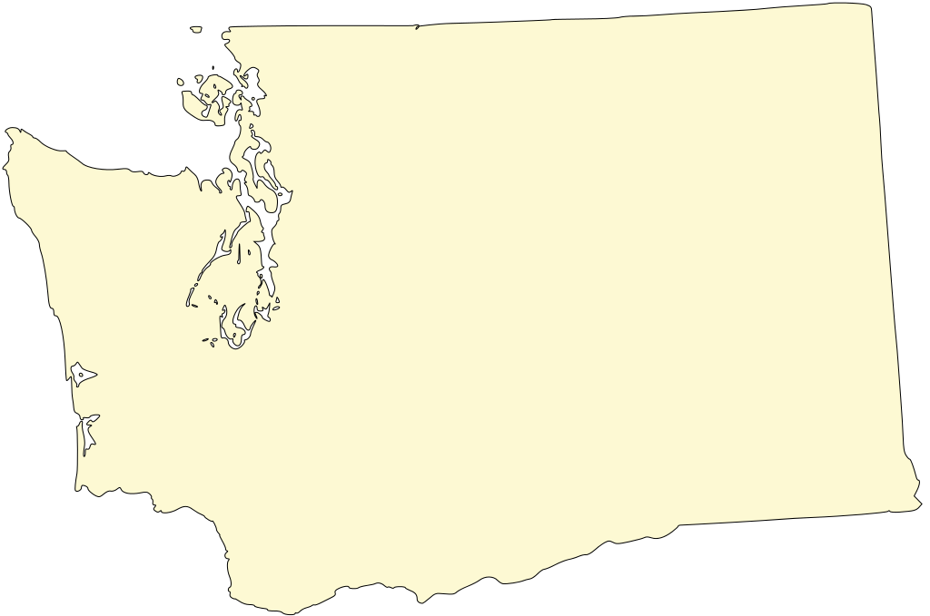
200+ Languages
Most ethnically diverse school district in the entire country
29 Federally Recognized Tribes
Iraq
Refugees
Somalia
DRC
Burma
Burma
4% of households live in linguistic isolation

Slide 13
Top 5 Languages Spoken
Chart A: Census Data
Chart B: OSPI Data
General Population | Speakers | LEP
Spanish | 550,000 | 226,00
Chinese | 87,000 | 46,000
Vietnamese | 61,000 | 37,000
Russian | 64,000 | 29,000
Korean | 43,000 | 21,000
Students | Speakers
Spanish | 61,558
Russian | 4,150
Vietnamese | 3,592
Somali | 2,260
Ukrainian | 2,197
HANDOUT 1C: Language Data

Slide 14
I’m from the U.S
I’m from Jamaica
Good health outcomes
Je suis du Cameroun
Linguistically appropriate
Culturally appropriate
Linguistically appropriate

Slide 15
Good health outcomes
Linguistically appropriate
Linguistically appropriate
Linguistically appropriate
Culturally appropriate
Culturally appropriate
Culturally appropriate

Slide 16
Why Implement CLAS?
Respond to demographic changes
Eliminate long-standing disparities
Change organizational culture
Improve quality of services and outcomes
Meet legislative and accreditation mandates
Gain a competitive edge in the market place
Decrease likelihood of liability claims
Maintain credibility

Slide 17
Principal Standard
Provide effective, equitable, understandable, and respectful quality care and services that are responsive to diverse cultural health beliefs and practices, preferred languages, health literacy and other communication needs.
SMALL GROUP DISCUSSION: What is your organization doing to currently meet this standard?

Slide 18
Thank You!

